Slide 1


Sumdog at Didcot Primary Academy
Andrea Brown – assistant principal and Maths Lead
Chris LaMMING – Assistant Principal and Sumdog enthusiast

Slide 2
Aims
Demonstrate how we integrate Sumdog into our Maths curriculum.
Share our successes with Sumdog
Notes:
Chris

Slide 3
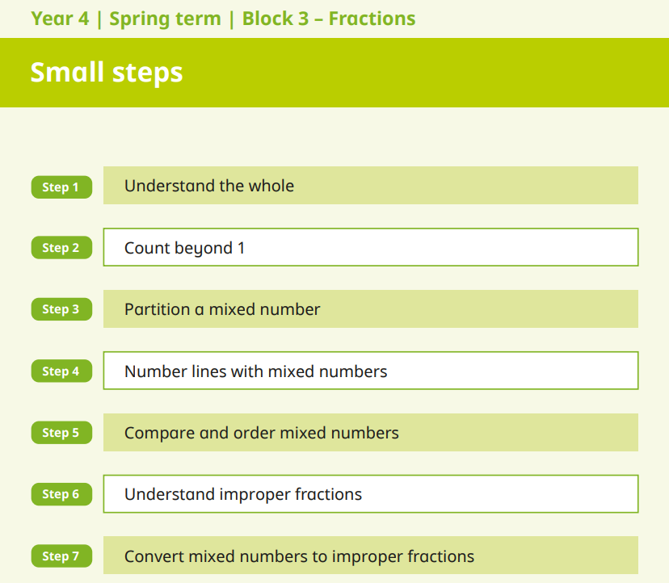
Maths Curriculum
Follow a Maths Mastery approach
Engaged with local maths hub
Use the White Rose scheme of learning, following the small steps in sequential lessons.
Parental support through online platforms, website updates and workshops
Notes:
Andrea
We use the White Rose Maths scheme to ensure a structured and progressive approach to teaching mathematics.
Lessons are carefully planned to build on prior knowledge and provide opportunities for students to explore concepts in depth.
We encourage students to communicate their mathematical thinking and reasoning, fostering a deeper understanding.
We believe in early intervention to address any misconceptions and ensure that all students can keep up with the curriculum.
We actively engage parents in their children's mathematical learning through various resources and workshops.

Slide 4
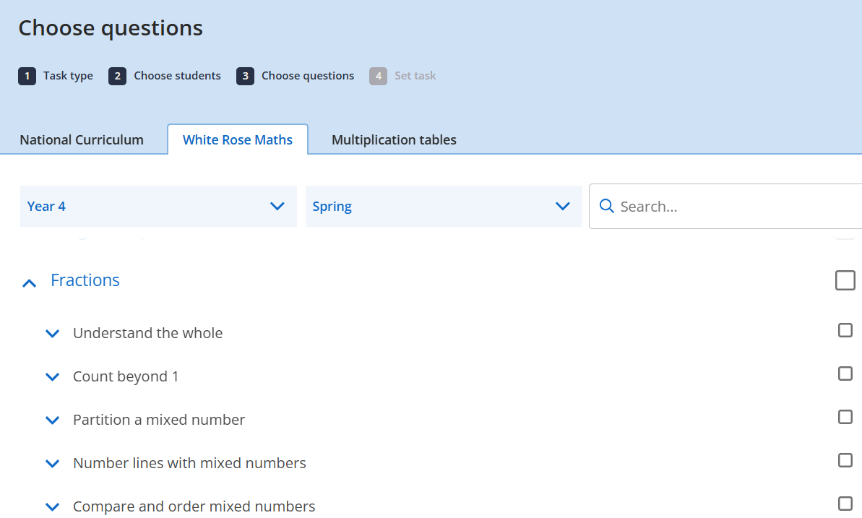
Integrating Sumdog
Pre and post-unit assessment
Pre-teaching opportunities
Alternative lesson tasks (Sumdog aligned to White Rose small steps)
End of lesson challenges
Daily/weekly spelling practice and tests in KS2
Targeted grammar revision
Lunchtime engagement in classrooms
In-school house competitions
Involvement in national competitions to boost motivation
Notes:
Andrea
Sumdog's flexibility allows teachers to use it in a way that best suits their students and teaching style.
From focused spelling practice to fun lunchtime activities, Sumdog is integrated into various aspects of the school day.
The alignment with White Rose Maths makes it easy to assign relevant tasks and track student progress.
Competitions add an element of excitement and encourage students to strive for improvement.

Slide 5
Impact and Results
Consistently high student engagement with Sumdog.
In the last two years, our children have completed:
5316 hours of learning time
Answered 2, 157, 732 questions
Improved targeting of pre-teaching by teachers and LSAs
Significant increase in Maths scores:
2024: 87% scored 100+ (34% scored 110+)
2023: 74% scored 100+ (32% scored 110+)
Significant increase in GPS scores:
2024: 84% scored 100+ (44% scored 110+)
2023: 73% scored 100+ (34% scored 110+)
Notes:
Chris
The positive impact of Sumdog is evident in the increased student engagement and improved academic outcomes.
Teachers are better equipped to identify and address individual learning needs.
The significant increase in GPS scores demonstrates the effectiveness of Sumdog in improving students' grammar, punctuation, and spelling skills.

Slide 6
Continued success and Investment
Recent investment in earbuds for Year 4-6 students to further enhance Sumdog experience.
Take an active role in helping shape upcoming features (i.e. fluency booster).
Notes:
Chris
The consistent improvement in maths scores further highlights the positive impact of Sumdog on student learning.
Our investment in earbuds for students demonstrates our commitment to maximizing the effectiveness of Sumdog and providing students with the best possible learning experience.
Active role includes fluency booster as well as in house visits from the design team.

Slide 7
Sumdog: A Positive Impact on Learning
Sumdog effectively engages students in maths, spelling and grammar fluency practice.
Teachers utilise Sumdog flexibly to meet diverse classroom needs.
Measurable positive impact on student outcomes.
Strong recommendation for other schools.
Notes:
Andrea
In conclusion, Sumdog has been a valuable asset to Didcot Primary Academy, fostering student engagement, improving academic outcomes, and providing teachers with a flexible and effective learning tool.
We highly recommend Sumdog to other schools looking to enhance their maths curriculum and inspire a love of learning in their students.

Slide 8
Any questions?

