Slide 1



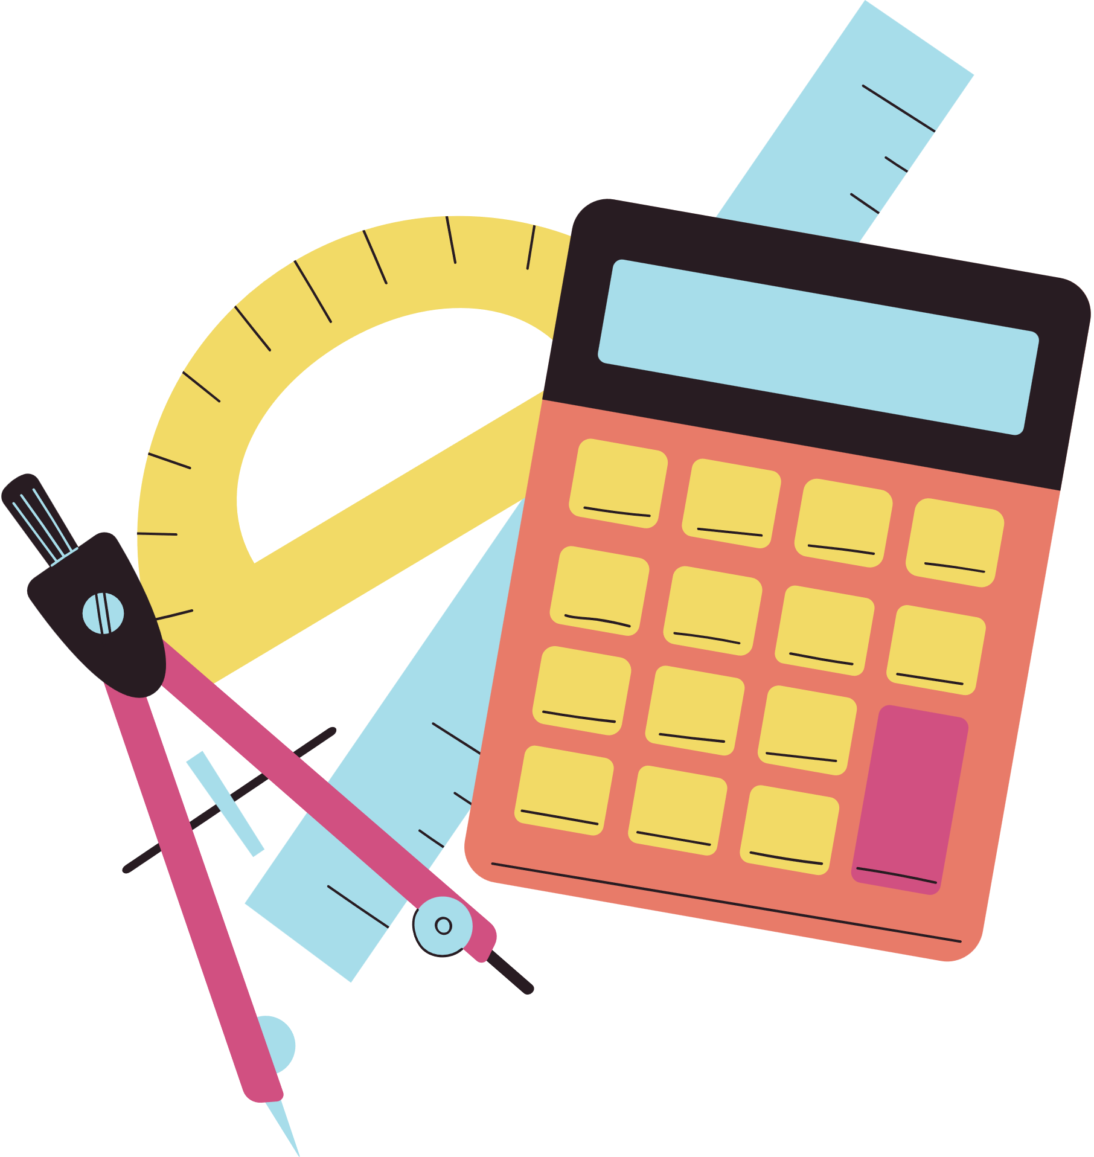
Sumdog Kick-off
Let’s get started

Slide 2



What is Sumdog?
Sumdog is an online tool to help us practise maths and spelling.
We will be using it:
•In class
•Homework

Slide 3
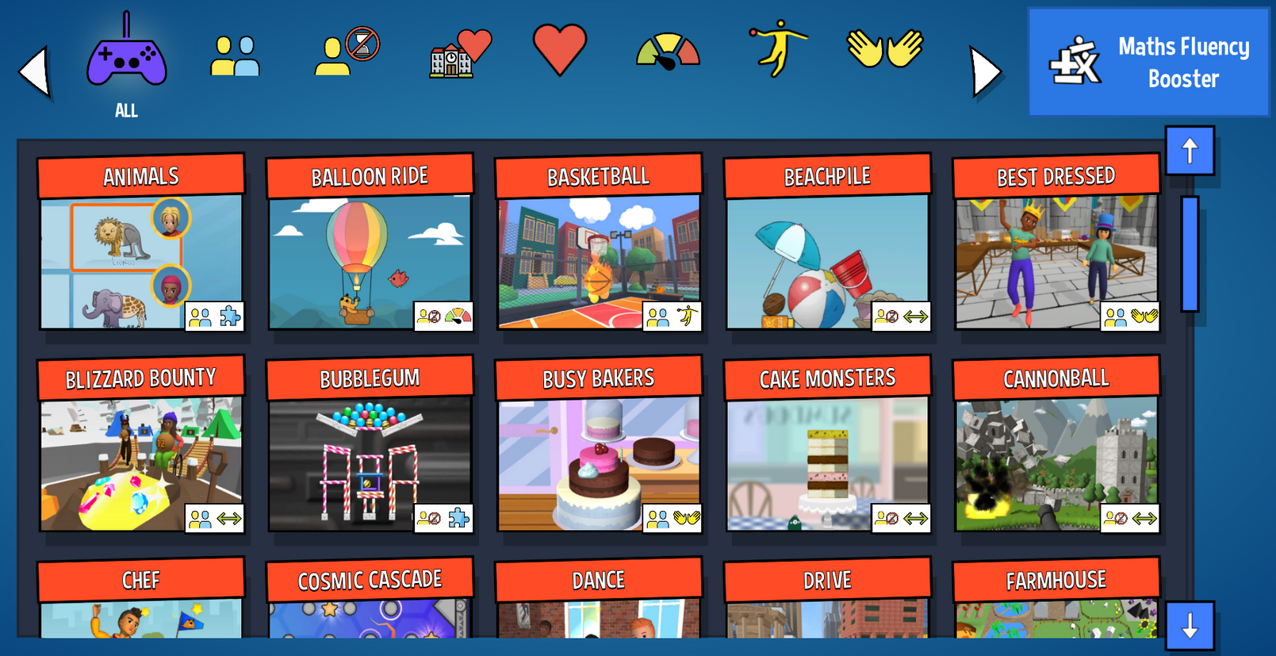
Variety of games
Notes:
There are over 30 games to choose from. For multiplayer games you have the choice of playing against the robot, class or world. Don’t worry, you can’t talk or message people in Sumdog, it is completely safe.

Slide 4
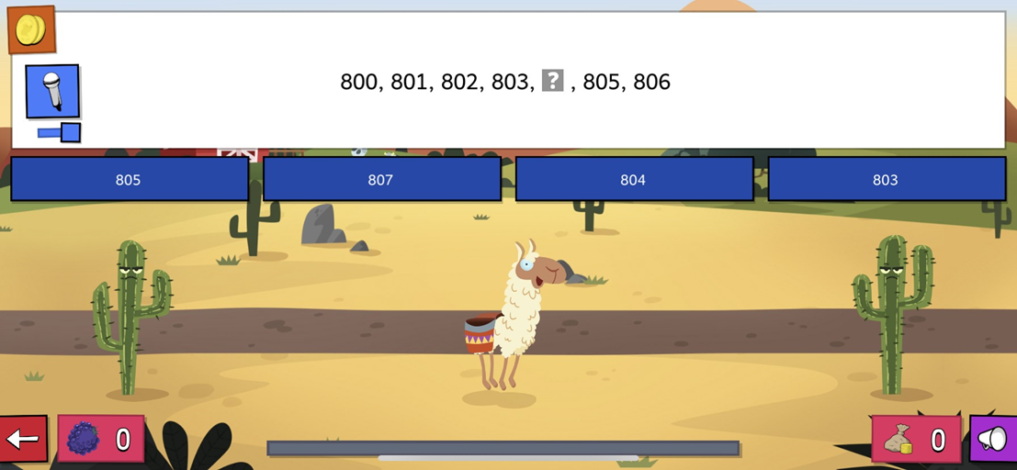
Multiple choice questions
Notes:
The Sumdog questions are multiple choice for maths. If you answer the question incorrectly, you will get another attempt at answering. You will only receive a coin for answering it correctly first time.

Slide 5
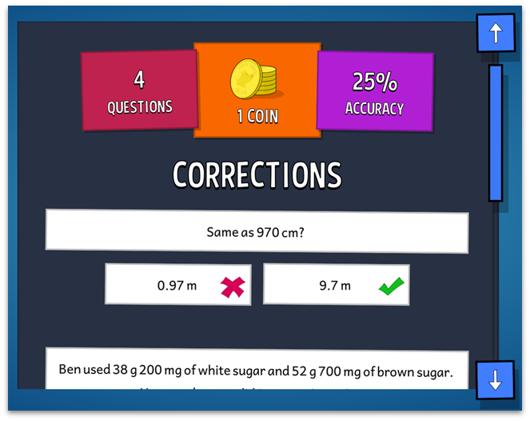
Multiple choice questions
Notes:
At the end of every game, if you any corrections, you will see a screen displaying them.

Slide 6
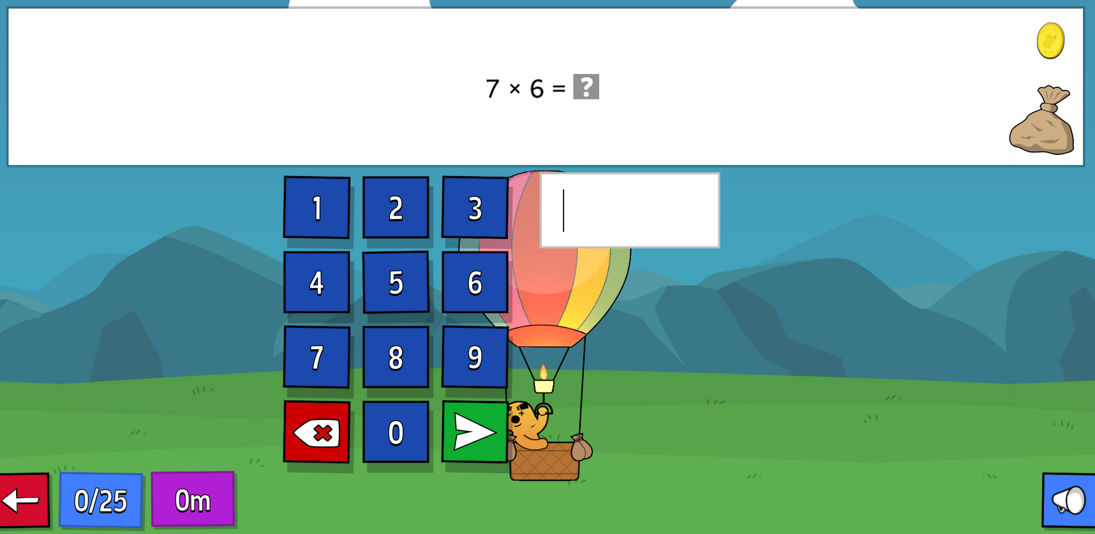
Typed questions
Notes:
You may occasionally see questions where you need to type your answer into a box instead of multiple-choice options. This will happen only on rare occasions when a teacher has requested that Sumdog provide these types of questions, and it will specifically be for times table questions.

Slide 7
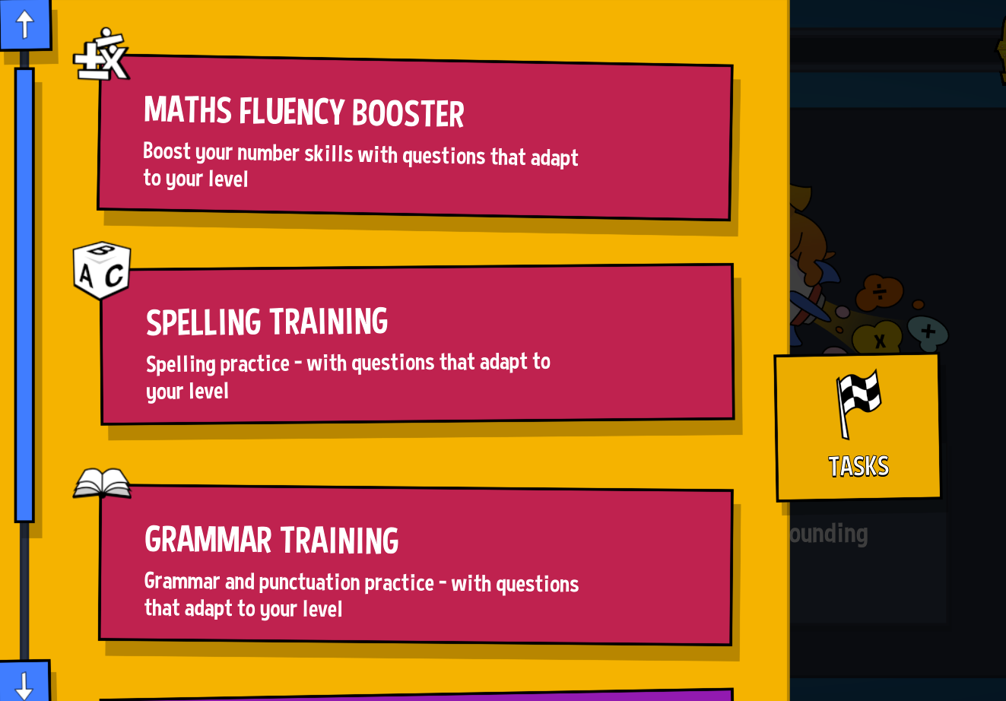
Tasks on Sumdog
Notes:
Once you login you'll be able to access your Task board to complete tasks set by your teacher. If there's no tasks there don't worry! You can click on Maths training and Sumdog will give you a maths skill to practise that is at your level.

Slide 8
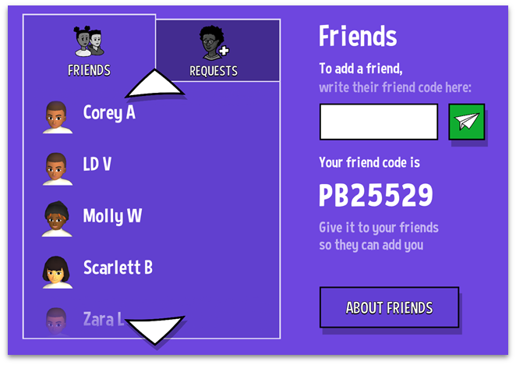
Friends
You can can add friends on Sumdog.
To add a friend, you will need to ask them for their unique ID.
Notes:
If you like, you can add friends on Sumdog. Having somebody as a friend allows you to view their avatar, animal rank, coin total and you can send them gifts.
Remember, only add people you know as friends. You should also not give out your unique friend ID to people you do not know.

Slide 9


How do I earn coins?
• Answering questions correctly
• Spending over 20 minutes a week practising maths
★ Coins are worth DOUBLE outside of school hours
Notes:
You can earn coins in lots of way.
By answering questions correctly
By spending at least 20 minutes a week on Sumdog answering questions in games
Coins are worth double when you play Sumdog outside of school hours
{Why not print off the parent letters and send them home with login details so children can play at home and earn double coins}

Slide 10
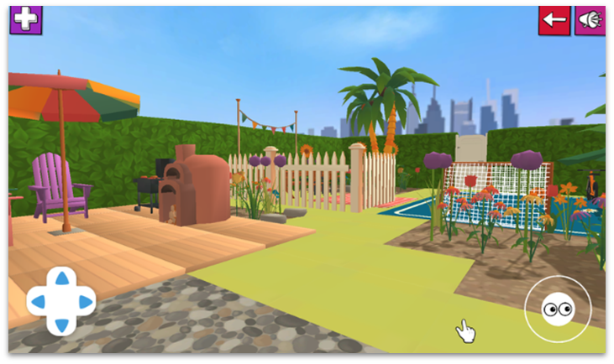
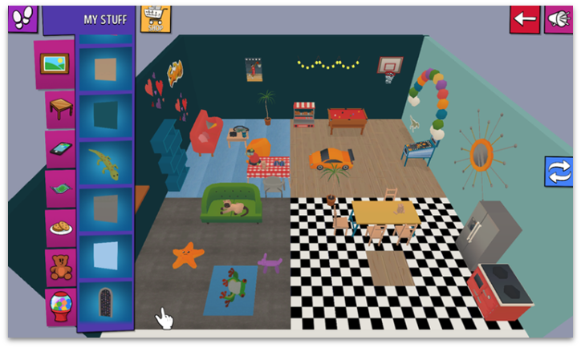
How do I earn coins?
3D house
3D garden
Notes:
You can spend your coins in your 3D garden or house.

Slide 11
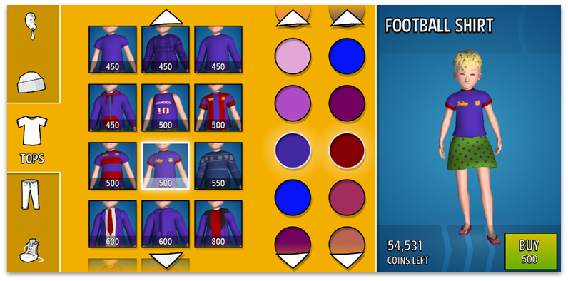
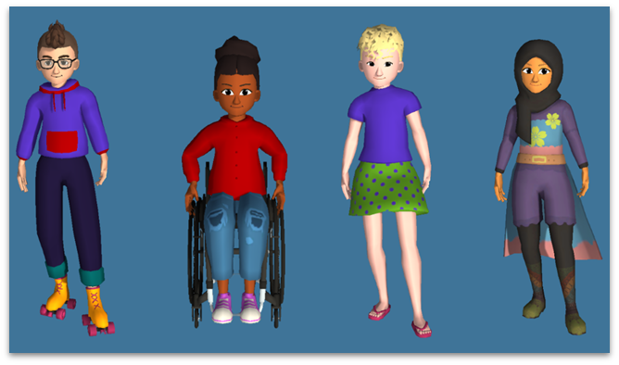
What can I do with my coins?
Notes:
You can also buy items for your 3D avatar.

Slide 12
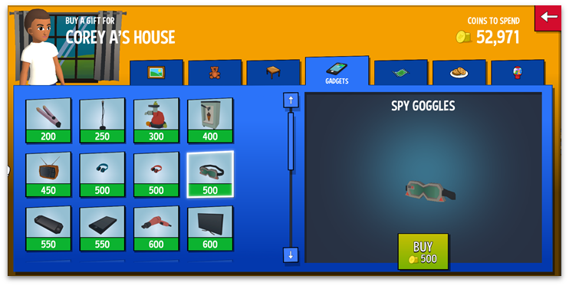
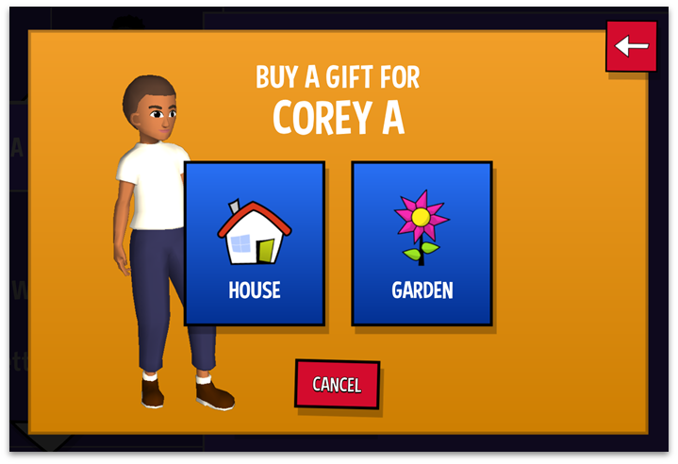
What can I do with my coins?
Notes:
You can send your friends gifts. One gift a day. Once you click on your friend’s name in the Friends tab, you will see the option to send a gift.

Slide 13

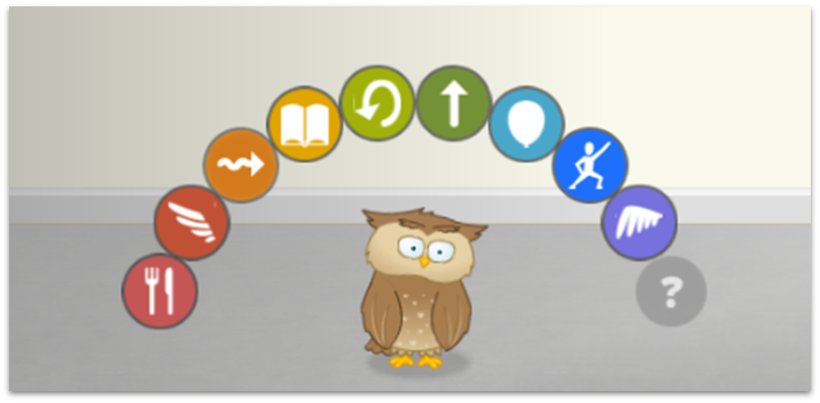
How do I know that I am doing well on Sumdog?
Notes:
Your pet is a great way to see how well you are doing on Sumdog. When you master a skill, Sumdog will reward your pet with a new trick. Each pet has 10 tricks to collect and there are 10 pets to collect.

Slide 14
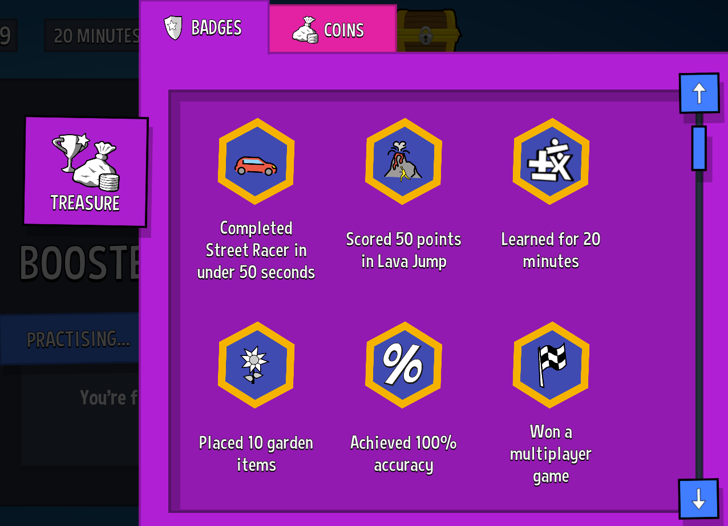
What are badges?
Notes:
You can earn badges when you hit certain achievements for example, you earn a badge when you win a multiplayer game or you place 10 items in your garden.

Slide 15

Weekly items
Notes:
Each week you can earn an exclusive item for your house or garden. These items will only be available throughout that week when you play Sumdog for at least 20 minutes, you will not find them in the Sumdog store.

Slide 16
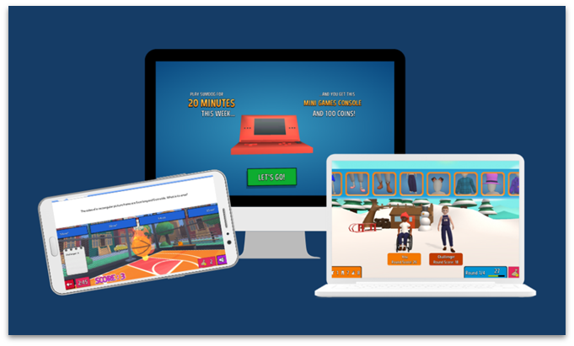
Next steps
Make sure you have your login details - ask your teacher if you don’t have them.
You can log in on any device, in school or at home.
Notes:
Teachers can find the pupils' logins on the main overview page when they log into their teacher account. These can be printed as cards with just the login details or the QR code, or the parent letter can be printed with each child’s login details included at the bottom.
To use Sumdog on a browser, go to www.play.sumdog.com
To use Sumdog on a tablet or a smartphone you need to download the free app.

Slide 17
Who is ready for fun maths practice?

